Slide 1
Matrix and Vector Multiplication Implementation

Slide 2
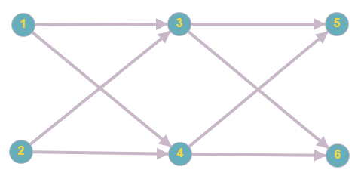

Slide 3

$$\left(\begin{matrix}V_{3} \\ V_{4}\end{matrix}\right)$$
$$=\left(\begin{matrix}w_{13} & w_{23} \\ w_{14} & w_{24}\end{matrix}\right)\left(\begin{matrix}V_{1} \\ V_{2}\end{matrix}\right)$$
$$=\left(\begin{matrix}1/R_{13} & 1/R_{23} \\ 1/R_{14} & 1/R_{24}\end{matrix}\right)\left(\begin{matrix}V_{1} \\ V_{2}\end{matrix}\right)$$
$$=\left(\begin{aligned}V_{1}\left(1/R_{13}\right)+V_{2}(1/R_{23}) \\ V_{1}\left(1/R_{14}\right)+V_{2}(1/R_{24})\end{aligned}\right)$$

Slide 4
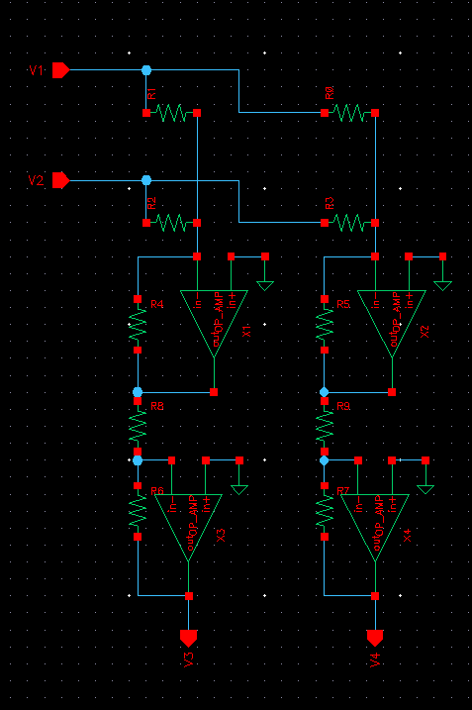

Slide 5
